Slide 1
Ecosystem Services Assessment Tool (ESAT) Interface Design – revision 4
By Shawn
August 15, 2019

Slide 2
General public login page

Slide 3
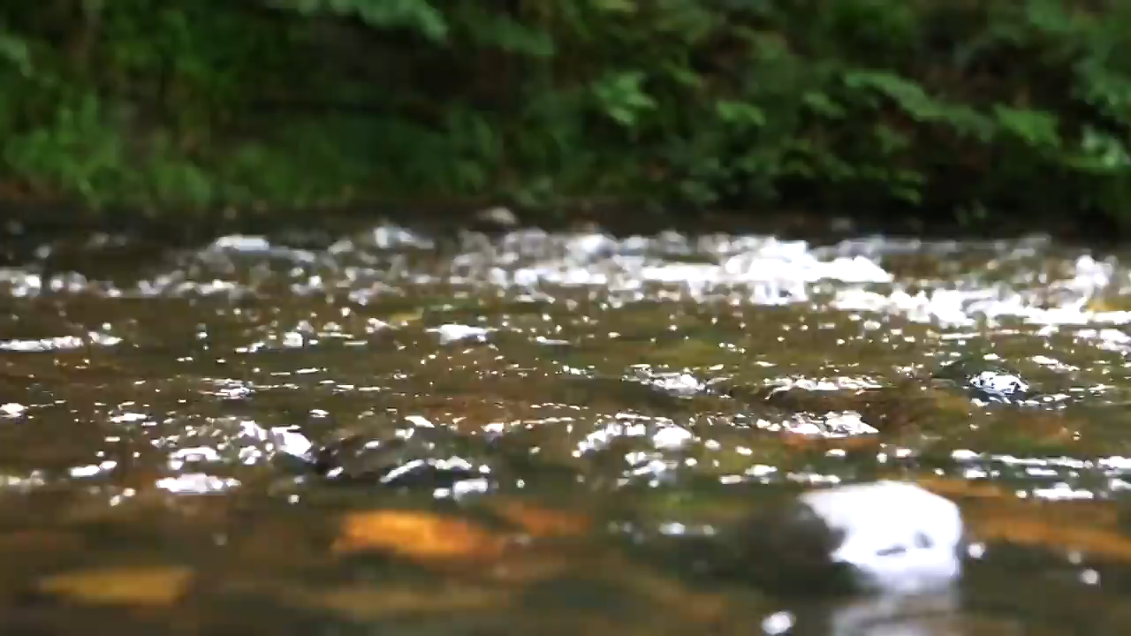
ESAT logo
Sign in to ESAT
Email address
Password
Sign in
Activate account
Forget password?
Contact admin

Slide 4
ESAT logo
Contact Us
Name *
Email address *
Message
Send Message
Notes:
Contact admin page

Slide 5
ESAT logo
Message sent
X
Your message has been sent to ESAT team.
We will respond as soon as possible.
Contact Us
Name *
Dismiss
Email address *
Message
Send Message
Notes:
Confirm message sent

Slide 6

ESAT logo
Validation code
Legend
Map | Satellite
X
Please input your 6 digit validation code:
X
Together we save our planet
123456
Submit
User profile
First name
Last name
Date of birth
Address
City
State/Province
Country
Account login
X
E-mail *
X
Password *
X
Confirm password *
N
Check here to confirm your profile and login information
+
−
Confirm
Notes:
Farm user register page – submit application

Slide 7
ESAT logo
Legend
Map | Satellite
Together we save our planet
User profile
First name
Last name
Date of birth
User is NOT allowed to change selections in the map
Address
City
State/Province
Country
Account login
X
E-mail *
X
Password *
X
Confirm password *
N
Check here to confirm your profile and login information
Click to trigger contact us
+
−
Confirm
Report Error
Notes:
Farm user register page – submit application

Slide 8
ESAT logo
Legend
Map | Satellite
Congratulations!
X
Together we save our planet
Your registration to ESAT is complete!
User profile
Dismiss
First name
Last name
Date of birth
Address
City
State/Province
Country
Account login
X
E-mail *
X
Password *
X
Confirm password *
N
Check here to confirm your profile and login information
+
−
Confirm
Report Error
Notes:
Farm user register page – submit application

Slide 9
ESAT logo
ESAT logo
Legend
Map | Satellite
Together we save our planet
Contact Us
User profile
Name *
First name
Last name
Date of birth
Email address *
Address
City
Message
State/Province
Country
Account login
X
E-mail *
X
Password *
X
Confirm password *
N
Check here to confirm your profile and login information
+
−
Confirm
Report Error
Send Error
Notes:
Farm user register page – submit application

Slide 10
Admin user version
Admin will manage watersheds/baseline scenarios, create manager accounts, assign watershed to manager

Slide 11




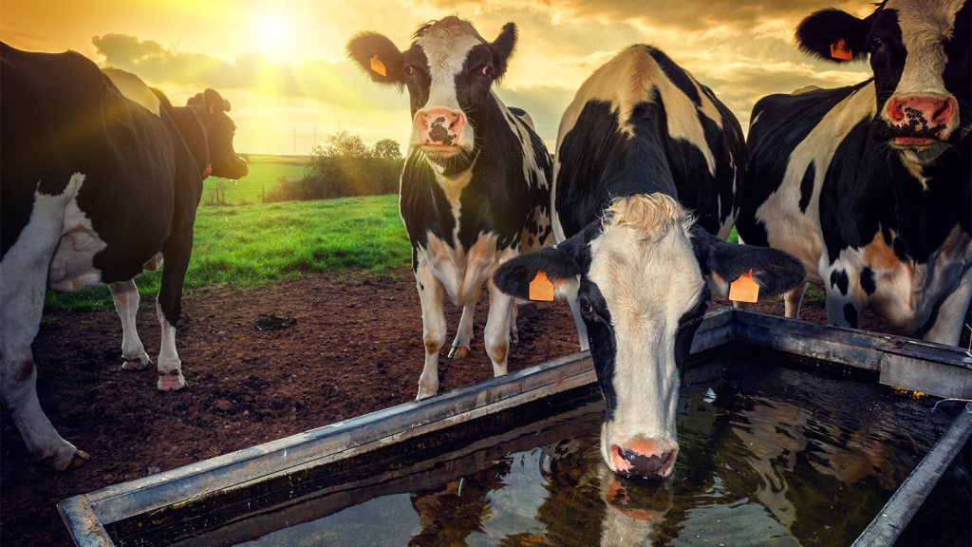
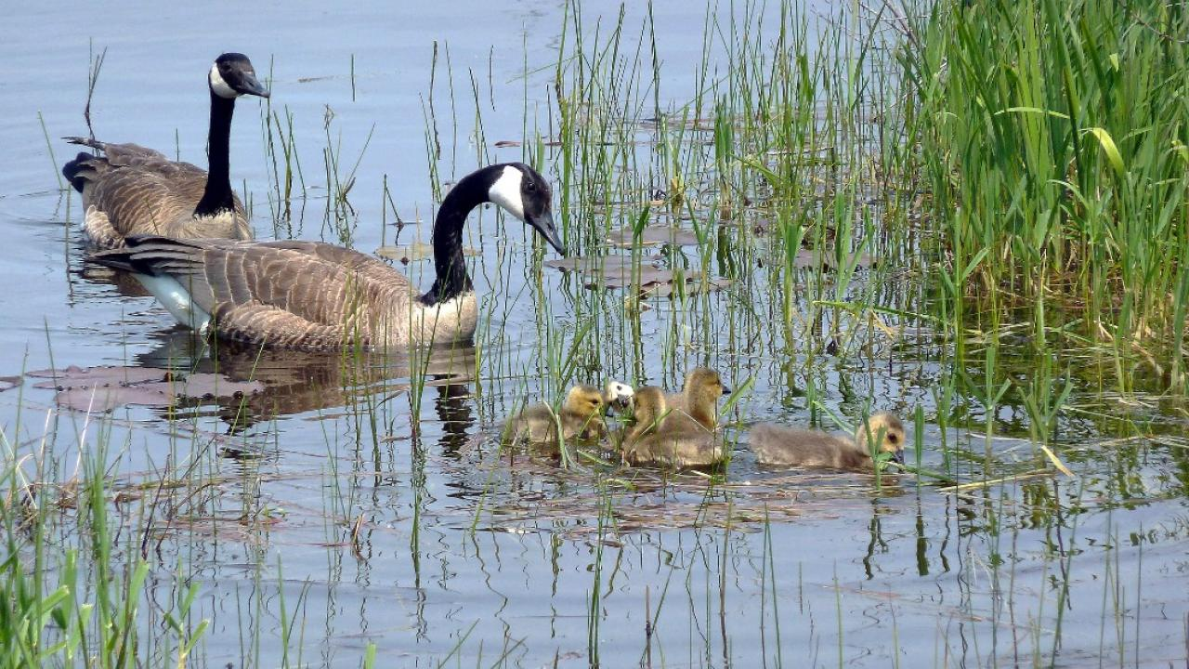

Logo
University of Guelph ESAT
Overview
shawn-uoguelph@email.ca (admin)
UNIVERSITY OF GUELPH
<<
Overview
Activated agriculture producers
4,532 5%
Conservation Manager
35
User
Watershed

Slide 12

Logo
University of Guelph ESAT
User management
shawn-uoguelph@email.ca (admin)
UNIVERSITY OF GUELPH
<<
Overview
Agriculture Producer
Producers explore available BMP options and their eco-services and costs in their farm.
Conservation Manager
Conservation managers explore/recommend BMP solutions in regional level (watershed or municipality).
User
Watershed
+ Add
Edit
+ Add
Edit
Technical Support
Technical support assess BMP eco-services and costs, maintain ESAT system, and provide technical solutions to users.
Click Edit to get the user list
Contact

Slide 13


Logo
University of Guelph ESAT
User management
shawn-uoguelph@email.ca (admin)
UNIVERSITY OF GUELPH
<<
Conservation manager list
Overview
ID | Name | Date of birth | Watershed | BMP | Update Date
#1001 | First name last name | MM/DD/YYYY | Watershed 1, watershed 2 … | BMP type 1, type 2 … | MM/DD/YYYY
#1002 | Shawn Shao | MM/DD/YYYY | Watershed 1, watershed 2 … | BMP type 1, type 2 … | 08/15/2019
#1003 | Wanhong Yang | MM/DD/YYYY | Watershed 1, watershed 2 … | BMP type 1, type 2 … | 08/10/2019
#1004 | User 1 | MM/DD/YYYY | Watershed 1, watershed 2 … | BMP type 1, type 2 … | MM/DD/YYYY
#1005 | User 2 | MM/DD/YYYY | Watershed 1, watershed 2 … | BMP type 1, type 2 … | MM/DD/YYYY
#1006 | User 3 | MM/DD/YYYY | Watershed 1, watershed 2 … | BMP type 1, type 2 … | MM/DD/YYYY
#1007 | User 4 | MM/DD/YYYY | Watershed 1, watershed 2 … | BMP type 1, type 2 … | MM/DD/YYYY
#1008 | User 5 | MM/DD/YYYY | Watershed 1, watershed 2 … | BMP type 1, type 2 … | MM/DD/YYYY
#1009 | User 6 | MM/DD/YYYY | Watershed 1, watershed 2 … | BMP type 1, type 2 … | MM/DD/YYYY
#1010 | User 7 | MM/DD/YYYY | Watershed 1, watershed 2 … | BMP type 1, type 2 … | MM/DD/YYYY
#1011 | User 8 | MM/DD/YYYY | Watershed 1, watershed 2 … | BMP type 1, type 2 … | MM/DD/YYYY
#1012 | User 9 | MM/DD/YYYY | Watershed 1, watershed 2 … | BMP type 1, type 2 … | MM/DD/YYYY
…
User
Watershed
<< | 1 | 2 | 3 | 4 | 5 | 6 | >>

Slide 14
Logo
University of Guelph ESAT
User management
shawn-uoguelph@email.ca (admin)
UNIVERSITY OF GUELPH
<<
Agriculture producer list
Overview
ID | Name | Date of birth | Municipality | BMP | Status | Update Date
#1001 | First name last name | MM/DD/YYYY | County 1 | BMP type 1, type 2 … | Activated | MM/DD/YYYY
#1002 | Shawn Shao | MM/DD/YYYY | County 2 | BMP type 1, type 2 … | Activated | 08/15/2019
#1003 | Wanhong Yang | MM/DD/YYYY | County 3 | BMP type 1, type 2 … | Activated | 08/10/2019
#1004 | User 1 | MM/DD/YYYY | … | BMP type 1, type 2 … | Registered not activated | MM/DD/YYYY
#1005 | User 2 | MM/DD/YYYY | … | BMP type 1, type 2 … | Registered not activated | MM/DD/YYYY
#1006 | User 3 | MM/DD/YYYY | … | BMP type 1, type 2 … | Not registered | MM/DD/YYYY
#1007 | User 4 | MM/DD/YYYY | … | BMP type 1, type 2 … | Not registered | MM/DD/YYYY
#1008 | User 5 | MM/DD/YYYY | … | BMP type 1, type 2 … | Not registered | MM/DD/YYYY
#1009 | User 6 | MM/DD/YYYY | … | BMP type 1, type 2 … | Not registered | MM/DD/YYYY
#1010 | User 7 | MM/DD/YYYY | … | BMP type 1, type 2 … | Not registered | MM/DD/YYYY
#1011 | User 8 | MM/DD/YYYY | … | BMP type 1, type 2 … | Not registered | MM/DD/YYYY
#1012 | User 9 | MM/DD/YYYY | … | BMP type 1, type 2 … |  | MM/DD/YYYY
…
User
Watershed
<< | 1 | 2 | 3 | 4 | 5 | 6 | >>

Slide 15
Logo
University of Guelph ESAT
Add User
shawn-uoguelph@email.ca (admin)
UNIVERSITY OF GUELPH
>>
User info
Location filter ^{(?)}
Legend
Map | Satellite
First name*
Last name*
Municipality
Date of birth*
Watershed
Address*
Address 2
Subwatershed
City*
All
Clear
State/Province*
Country*
Assign available BMP ^{(?)}
Government issued ID
Assign type
Driver’s license
Based on parcel location
Last 4 digits of social insurance number (SIN)
Edit individual BMP
User type
User type
Agriculture producer
N
Conservation manager
Click Search to check if database has information of this user. If true, fill in the existing information
+
−
Search
Add/Confirm
Notes:
Farm user register page – submit application

Slide 16
Logo
University of Guelph ESAT
Add User
shawn-uoguelph@email.ca (admin)
UNIVERSITY OF GUELPH
>>
User info
Location filter ^{(?)}
Legend
Map | Satellite
First name*
Last name*
 | Watershed
 | Stream
 | BMP type 3 Selected
Municipality
Date of birth*
Watershed
Address*
Address 2
Subwatershed
City*
All
Clear
State/Province*
Country*
Assign available BMP ^{(?)}
Government issued ID
Assign type
Driver’s license
Based on location overlap
Last 4 digits of social insurance number (SIN)
Edit individual BMP
User type
Agriculture producer
BMP type
BMP type 1
N
BMP type 2
BMP type 3
+
−
…
Search
Add new
Notes:
Farm user register page – submit application

Slide 17

Logo
University of Guelph ESAT
Watershed management
shawn-uoguelph@email.ca (admin)
UNIVERSITY OF GUELPH
<<
Watershed list
Overview
Watershed | Name | Status | Update Date | Online
#1001 | Inidianfarm Creek | Online | Live
#1002 | Gully Creek | Database ready, offline | 08/15/2019
#1003 | Modeste Creek | Database updating, offline | 08/10/2019
#1004 | Sample 1 | No data, offline | -
#1005 | Sample 2 | No data, offline | -
#1006 | Sample 3 | No data, offline | -
#1007 | Sample 4 | No data, offline | -
#1008 | Sample 5 | No data, offline | -
#1009 | Sample 6 | No data, offline | -
#1010 | Sample 7 | No data, offline | -
#1011 | Sample 8 | No data, offline | -
#1012 | Sample 9 | No data, offline | -
…
User
Watershed
<< | 1 | 2 | 3 | 4 | 5 | 6 | >>

Slide 18
Manager user version

Slide 19

Logo
Overview
shawn-uoguelph@email.ca (admin)
UNIVERSITY OF GUELPH
University of Guelph ESAT
Project
Map | Satellite
Summarization level
Legend
LSD or Parcel
 | Watershed
 | Stream
Farm
Municipality
Subwatershed
Feedback button trigger contact us panel
Watershed
N
+
−
LSD or Parcel | Farm | Area (ha) | Elevation (m) | Slope (%) | Dominant land use | Dominant soil texture | Runoff (mm/yr) | Runoff std (mm/yr) | TSS (ton/yr) | TSS std (ton/yr) | …
1
2
3
…
Notes:
Watershed result display
System supports different level display, LSD or Parcel, municipality, or watershed

Slide 20
Logo
Overview
shawn-uoguelph@email.ca (admin)
UNIVERSITY OF GUELPH
University of Guelph ESAT
Project
ESAT logo
Map | Satellite
Summarization level
Legend
LSD or Parcel
 | Watershed
 | Stream
Contact Us
Farm
Municipality
Name *
Subwatershed
Watershed
Email address *
Message
N
+
−
LSD or Parcel | Farm | Area (ha) | Elevation (m) | Slope (%) | Dominant land use | Dominant soil texture | Runoff (mm/yr) | Runoff std (mm/yr) | TSS (ton/yr) | TSS std (ton/yr) | …
1
2
3
…
Feedback button trigger contact us panel
Send Message
Notes:
Watershed result display
System supports different level display, LSD or Parcel, municipality, or watershed

Slide 21
Logo
Overview
Project
shawn-uoguelph@email.ca (admin)
UNIVERSITY OF GUELPH
University of Guelph ESAT
Add or Open project ^{(?)}
Reminder
+
X
Add Project
You haven’t create any project yet.
Press OK to create a new project
Date | Title
OK
If no project has been created. System will remind user to create one.
TP Off-site Effectiveness (kg/yr)
Notes:
Manager project management page – no project detected

Slide 22

Logo
Overview
Project
shawn-uoguelph@email.ca (admin)
UNIVERSITY OF GUELPH
University of Guelph ESAT
Add or Open project ^{(?)}
+
Add Project
Date | Title
2019-07-05 | Modeste exploration 1
2019-06-21 | Test eco 2
2019-06-20 | Indianfarm budget 1
2019-05-15 | Broughton budget
2018-02-11 | Gully eco
…
User can create a new project using “Add Project” button
User can open or delete project using buttons here
TP Off-site Effectiveness (kg/yr)
Notes:
Manager project management page – view existing projects

Slide 23
Logo
Overview
Project
shawn-uoguelph@email.ca (admin)
UNIVERSITY OF GUELPH
University of Guelph ESAT
Add or Open project ^{(?)}
+
Add Project
Date | Title
2019-07-05 | Modeste exploration 1
2019-06-21 | Test eco 2
2019-06-20 | Indianfarm budget 1
2019-05-15 | Broughton budget
2018-02-11 | Gully eco
…
X
Add new project
Title
Test project
Description
This is a test project created by Shawn
Watershed
Watershed drop list
Watershed list support multiple selection
Top item (default) is All, meaning all selected
Baseline ^{(?)}
All
Baseline drop list
Watershed 1
BMP Scale ^{(?)}
Field BMP scale drop list
Watershed 2
Watershed 3
Add
Cancel
…
Effectiveness drop list (E.g. TP off-site)
Notes:
Manager add new project

Slide 24
Logo
Overview
Project
shawn-uoguelph@email.ca (admin)
UNIVERSITY OF GUELPH
University of Guelph ESAT
Add or Open project ^{(?)}
+
Add Project
Date | Title
2019-07-05 | Modeste exploration 1
2019-06-21 | Test eco 2
2019-06-20 | Indianfarm budget 1
2019-05-15 | Broughton budget
2018-02-11 | Gully eco
…
X
Add new project
Title
Test project
Description
This is a test project created by Shawn
Watershed
Watershed drop list
Baseline ^{(?)}
Baseline drop list
BMP Scale ^{(?)}
Field BMP scale drop list
Add
Cancel
Effectiveness drop list (E.g. TP off-site)
Notes:
Manager add new project

Slide 25


Logo
University of Guelph ESAT
Project name
shawn-uoguelph@email.ca (admin)
UNIVERSITY OF GUELPH
Legend
Map | Satellite
Summarization level
Baseline information
 | Watershed
 | Stream
LSD or Parcel
Existing BMP summary^{(?)}
Intelligent BMP selection
Farm
BMP | Count | Area (ha) | Cost ($/ha)
Cover crop | 132
Wetland | 15
…
Total cost ($/yr) | 0
Municipality
BMP selection & overview
Subwatershed
Watershed
N
+
−
Watershed outlet summary^{(?)}
Effectiveness | Value
Total P off-site (kg/yr) | -3,521
Carbon (ton/yr) | 151
Flood mitigation
Soil water
…
LSD or Parcel | Area (ha) | Elevation (m) | Slope (%) | Dominant land use | Dominant soil texture | Runoff (mm/yr) | Runoff std (mm/yr) | TSS (ton/yr) | TSS std (ton/yr) | …
1
2
3
…
Export ^{(?)}
Report ^{(?)}
Notes:
Watershed result display
System supports different level display, LSD or Parcel, municipality, or watershed

Slide 26
Logo
University of Guelph ESAT
Project name
shawn-uoguelph@email.ca (admin)
UNIVERSITY OF GUELPH
Legend
Map | Satellite
Summarization level
Baseline information
 | Watershed
 | Stream
LSD or Parcel
Existing BMP summary^{(?)}
Intelligent BMP selection
Farm
BMP | Count | Area (ha) | Cost ($/ha)
Cover crop | 132
Wetland | 15
…
Total cost ($/yr) | 0
Municipality
BMP selection & overview
Subwatershed
Watershed
N
+
−
Watershed outlet summary^{(?)}
Effectiveness | Value
Total P off-site (kg/yr) | -3,521
Carbon (ton/yr) | 151
Flood mitigation
Soil water
…
Farm | Area (ha) | Elevation (m) | Slope (%) | Dominant land use | Dominant soil texture | Runoff (mm/yr) | Runoff std (mm/yr) | TSS (ton/yr) | TSS std (ton/yr) | …
1
2
3
…
Export ^{(?)}
Report ^{(?)}
Notes:
Watershed result display
System supports different level display, LSD or Parcel, municipality, or watershed

Slide 27
Logo
University of Guelph ESAT
Project name
shawn-uoguelph@email.ca (admin)
UNIVERSITY OF GUELPH
Legend
Map | Satellite
Summarization level
Baseline information
 | Watershed
 | Stream
LSD or Parcel
Existing BMP summary^{(?)}
Intelligent BMP selection
Farm
BMP | Count | Area (ha) | Cost ($/ha)
Cover crop | 132
Wetland | 15
…
Total cost ($/yr) | 0
Municipality
BMP selection & overview
Subwatershed
Watershed
N
+
−
Watershed outlet summary^{(?)}
Effectiveness | Value
Total P off-site (kg/yr) | -3,521
Carbon (ton/yr) | 151
Flood mitigation
Soil water
…
Municipality | Area (ha) | Elevation (m) | Slope (%) | Dominant land use | Dominant soil texture | Runoff (mm/yr) | Runoff std (mm/yr) | TSS (ton/yr) | TSS std (ton/yr) | …
County 1
County 2
MD sample
…
Export ^{(?)}
Report ^{(?)}
Notes:
Watershed result display

Slide 28
Logo
University of Guelph ESAT
Project name
shawn-uoguelph@email.ca (admin)
UNIVERSITY OF GUELPH
Legend
Map | Satellite
Summarization level
Baseline information
 | Watershed
 | Stream
LSD or Parcel
Existing BMP summary^{(?)}
Intelligent BMP selection
Farm
BMP | Count | Area (ha) | Cost ($/ha)
Cover crop | 132
Wetland | 15
…
Total cost ($/yr) | 0
Municipality
BMP selection & overview
Subwatershed
Watershed
N
+
−
Watershed outlet summary^{(?)}
Effectiveness | Value
Total P off-site (kg/yr) | -3,521
Carbon (ton/yr) | 151
Flood mitigation
Soil water
…
Contributing area to reach | Area (ha) | Elevation (m) | Slope (%) | Dominant land use | Dominant soil texture | Runoff (mm/yr) | Runoff std (mm/yr) | TSS (ton/yr) | TSS std (ton/yr) | …
251
Export ^{(?)}
Report ^{(?)}
Notes:
Watershed result display

Slide 29
Logo
University of Guelph ESAT
Project name
shawn-uoguelph@email.ca (admin)
UNIVERSITY OF GUELPH
Legend
Map | Satellite
Summarization level
Baseline information
 | Watershed
 | Stream
LSD or Parcel
Existing BMP summary^{(?)}
Intelligent BMP selection
Farm
BMP | Count | Area (ha) | Cost ($/ha)
Cover crop | 132
Wetland | 15
…
Total cost ($/yr) | 0
Municipality
BMP selection & overview
Subwatershed
Watershed
N
+
−
Watershed outlet summary^{(?)}
Effectiveness | Value
Total P off-site (kg/yr) | -3,521
Carbon (ton/yr) | 151
Flood mitigation
Soil water
…
Watershed | Area (ha) | Elevation (m) | Slope (%) | Dominant land use | Dominant soil texture | Runoff (mm/yr) | Runoff std (mm/yr) | TSS (ton/yr) | TSS std (ton/yr) | …
Modeste Creek watershed
Export ^{(?)}
Report ^{(?)}
Notes:
Watershed result display

Slide 30
Intelligent BMP selection tool recommends BMPs in different locations according to user’s budget constraints or eco-service targets.
Logo
University of Guelph ESAT
Project name
shawn-uoguelph@email.ca (admin)
UNIVERSITY OF GUELPH
Legend
Map | Satellite
Location filter ^{(?)}
Baseline information
 | Watershed
 | Stream
 | LSD or Parcel BMP type 1
Municipality
Intelligent BMP selection
Subwatershed
BMP Type 1
All
Clear
BMP Type 2
Dismiss
Never show again
Intelligent setting ^{(?)}
BMP Type 3
Intelligent mode
BMP selection & overview
Budget ^{(?)}
Budget ^{(?)}
Budget ($)
20000
When click on “Intelligent BMP selection”, show introduction of Intelligent BMP selection
After click “Dismiss”, automatic select first BMP type
N
+
−
Option
Select | LSD or Parcel | Farm | BMP area (ha) | On-site effectiveness (kg/ha/yr) | Off-site effectiveness (kg/ha/yr) | Cost ($) | On-site cost-effectiveness | Off-site cost-effectiveness
 | 1
 | 11
 | 2
 | 7
 | 9
 | …
Run Intelligent Selection ^{(?)}
Notes:
Intelligent BMP selection tool introduction

Slide 31
Logo
University of Guelph ESAT
Project name
shawn-uoguelph@email.ca (admin)
UNIVERSITY OF GUELPH
Legend
Map | Satellite
Location filter ^{(?)}
Baseline information
 | Watershed
 | Stream
 | LSD or Parcel BMP type 1
Municipality
Municipality and Subwatershed offer two level filter to define visible LSD or Parcel in the map and table
When select Municipality or Subwatershed from the list, only show LSD or parcel of that Municipality or Subwatershed in the map and table
Municipality and Subwatershed lists are dynamic updating based on the other list. For example, if municipality selected, only overlapping subwatersheds will be visible in subwatershed list and vice versa.
Select All to show all Municipality or Subwatershed
All
Intelligent BMP selection
Subwatershed
BMP Type 1
County 1
All
Clear
BMP Type 2
…
BMP Type 3
Intelligent setting ^{(?)}
BMP selection & overview
Intelligent mode
Budget
Budget ^{(?)}
Budget ^{(?)}
Budget ($)
Budget ($)
N
Eco-service
+
−
Option
Select | LSD or Parcel | Farm | BMP area (ha) | On-site effectiveness (kg/ha/yr) | Off-site effectiveness (kg/ha/yr) | Cost ($) | On-site cost-effectiveness | Off-site cost-effectiveness
 | 1
 | 11
 | 2
 | 7
 | 9
 | …
The “Option” tab will be used to switch between table view and ranking chart view
In table, one effectiveness item (e.g. TP) will have 5 result columns, On-site effectivenessiveness (unit), Off-site effectivenessiveness (unit), Cost (unit), On-site cost-effectiveness, and Off-site cost-effectiveness
If Off-site effectivenessiveness is not available (e.g. carbon), only 3 columns will show, On-site effectivenessiveness (unit), Cost (unit), and On-site cost-effectiveness
Run Intelligent Selection ^{(?)}
Notes:
Intelligent BMP selection on BMP type 1

Slide 32
Logo
University of Guelph ESAT
Project name
shawn-uoguelph@email.ca (admin)
UNIVERSITY OF GUELPH
Legend
Map | Satellite
Location filter ^{(?)}
Baseline information
 | Watershed
 | Stream
 | LSD or Parcel BMP type 1
Municipality
Intelligent BMP selection
Subwatershed
BMP Type 1
All
Clear
BMP Type 2
Intelligent setting ^{(?)}
BMP Type 3
Intelligent mode
BMP selection & overview
Click “All” will add all LSD or Parcel of current view to the selection pool.
Click “Clear” will remove all LSD or Parcel of current view from the selection pool.
Budget ^{(?)}
Budget ^{(?)}
Budget ($)
Budget ($)
N
+
−
Option
Select | LSD or Parcel | Farm | BMP area (ha) | On-site effectiveness (kg/ha/yr) | Off-site effectiveness (kg/ha/yr) | Cost ($) | On-site cost-effectiveness | Off-site cost-effectiveness
 | 1
 | 11
 | 2
 | 7
 | 9
 | …
Run Intelligent Selection ^{(?)}
Notes:
Intelligent BMP selection on BMP type 1

Slide 33
Logo
University of Guelph ESAT
Project name
shawn-uoguelph@email.ca (admin)
UNIVERSITY OF GUELPH
Legend
Map | Satellite
Location filter ^{(?)}
Baseline information
 | Watershed
 | Stream
 | LSD or Parcel BMP type 1
Municipality
Intelligent BMP selection
Subwatershed
BMP Type 1
All
Clear
BMP Type 2
Intelligent setting ^{(?)}
BMP Type 3
Intelligent mode
BMP selection & overview
Budget ^{(?)}
Budget ^{(?)}
Budget ($)
20000
N
+
−
Select | LSD or Parcel | Farm | BMP area (ha) | On-site effectiveness (kg/ha/yr) | Off-site effectiveness (kg/ha/yr) | Cost ($) | On-site cost-effectiveness | Off-site cost-effectiveness
 | 1
 | 11
 | 2
 | 7
 | 9
 | …
Table view ^{(?)}
Ranking chart view ^{(?)}
Cost and Effectiveness ^{(?)}
TP
Option
Run Intelligent Selection ^{(?)}
Notes:
Intelligent BMP selection – table view option

Slide 34
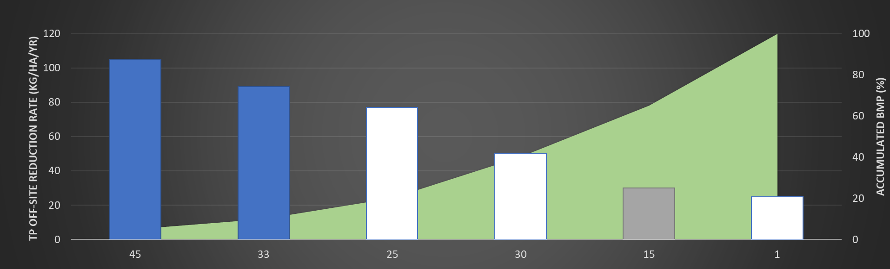
Logo
University of Guelph ESAT
Project name
shawn-uoguelph@email.ca (admin)
UNIVERSITY OF GUELPH
Legend
Map | Satellite
Location filter ^{(?)}
Baseline information
 | Watershed
 | Stream
 | LSD or Parcel BMP type 1
Municipality
Intelligent BMP selection
Subwatershed
BMP Type 1
All
Clear
BMP Type 2
Intelligent setting ^{(?)}
BMP Type 3
Intelligent mode
BMP selection & overview
Budget ^{(?)}
Budget ^{(?)}
Budget ($)
20000
N
+
−
Table view ^{(?)}
Ranking chart view ^{(?)}
There are two level of drop list to define ranking chart
Cost and Effectiveness ^{(?)}
TP
Off-site effectiveness
Option
Run Intelligent Selection ^{(?)}
Notes:
Intelligent BMP selection – chart view option

Slide 35
Logo
University of Guelph ESAT
Project name
shawn-uoguelph@email.ca (admin)
UNIVERSITY OF GUELPH
Legend
Map | Satellite
Location filter ^{(?)}
Baseline information
 | Watershed
 | Stream
 | LSD or Parcel BMP type 1
Municipality
Intelligent BMP selection
Subwatershed
BMP Type 1
All
Clear
BMP Type 2
Intelligent setting ^{(?)}
BMP Type 3
Intelligent mode
BMP selection & overview
Budget ^{(?)}
Budget ^{(?)}
Budget ($)
20000
N
+
−
Chart will indicate which location is selected, which is included in baseline, and the unselected locations
Option
Run Intelligent Selection ^{(?)}
Notes:
Budget mode

Slide 36
Logo
University of Guelph ESAT
Project name
shawn-uoguelph@email.ca (admin)
UNIVERSITY OF GUELPH
Legend
Map | Satellite
Location filter ^{(?)}
Baseline information
 | Watershed
 | Stream
 | LSD or Parcel BMP type 1
Municipality
Intelligent BMP selection
Subwatershed
BMP Type 1
All
Clear
BMP Type 2
Intelligent setting ^{(?)}
BMP Type 3
Intelligent mode
BMP selection & overview
Budget
Customize weight
Eco-service
Add constraint
N
# | Type | Value
1 | TP on-site | -15%
2 | Carbon | +10%
3 | Sediment off-site | -20%
..
+
−
Option
Select | LSD or Parcel | Farm | BMP area (ha) | On-site effectiveness (kg/ha/yr) | Off-site effectiveness (kg/ha/yr) | Cost ($) | On-site cost-effectiveness | Off-site cost-effectiveness
 | 1
 | 11
 | 2
 | 7
 | 9
 | …
Run Intelligent Selection ^{(?)}
Notes:
Eco-service mode

Slide 37
Logo
University of Guelph ESAT
Project name
shawn-uoguelph@email.ca (admin)
UNIVERSITY OF GUELPH
Legend
Map | Satellite
Location filter ^{(?)}
Baseline information
 | Watershed
 | Stream
 | LSD or Parcel BMP type 1
Municipality
Intelligent BMP selection
Subwatershed
BMP Type 1
All
Clear
BMP Type 2
Intelligent setting ^{(?)}
BMP Type 3
Intelligent mode
BMP selection & overview
Customize weight
N
+ Add constraint
# | Type | Value
1 | TP on-site | -15%
2 | Carbon | +10%
3 | Sediment off-site | -20%
..
+
−
Option
Select | LSD or Parcel | Farm | BMP area (ha) | On-site effectiveness (kg/ha/yr) | Off-site effectiveness (kg/ha/yr) | Cost ($) | On-site cost-effectiveness | Off-site cost-effectiveness
 | 1
 | 11
 | 2
 | 7
 | 9
 | …
Run Intelligent Selection ^{(?)}
Notes:
Eco-service mode

Slide 38
Logo
University of Guelph ESAT
Project name
shawn-uoguelph@email.ca (admin)
UNIVERSITY OF GUELPH
Legend
Map | Satellite
Location filter ^{(?)}
 | Watershed
 | Stream
 | LSD or Parcel BMP type 1
Eco-service Weight
Baseline information
X
Municipality
TP off-site | 30
Carbon | 20
Flood mitigation | 10
… | …
Intelligent BMP selection
Subwatershed
BMP Type 1
All
Clear
BMP Type 2
Intelligent setting ^{(?)}
BMP Type 3
Intelligent mode
BMP selection & overview
Customize weight
N
+ Add constraint
# | Type | Value
1 | TP on-site | -15%
2 | Carbon | +10%
3 | Sediment off-site | -20%
..
OK
Cancel
+
−
When click “Customize weight“ button, user can specify Eco-service Weight in different service type.
When click OK, system will check and inform user all weights must add up to 100.
Option
Select | LSD or Parcel | Farm | BMP area (ha) | On-site effectiveness (kg/ha/yr) | Off-site effectiveness (kg/ha/yr) | Cost ($) | On-site cost-effectiveness | Off-site cost-effectiveness
 | 1
 | 11
 | 2
 | 7
 | 9
 | …
Run Intelligent Selection ^{(?)}
Notes:
Eco-service mode

Slide 39
Logo
University of Guelph ESAT
Project name
shawn-uoguelph@email.ca (admin)
UNIVERSITY OF GUELPH
Legend
Map | Satellite
Location filter ^{(?)}
Baseline information
 | Watershed
 | Stream
 | LSD or Parcel BMP type 1
Municipality
Intelligent BMP selection
Subwatershed
BMP Type 1
All
Clear
BMP Type 2
Intelligent setting ^{(?)}
X
Add constraint
BMP Type 3
Intelligent mode
BMP selection & overview
Constraint ^{(?)}
Type drop list
Customize weight
Target ^{(?)}
-35%
%
N
+ Add constraint
Add
Cancel
# | Type | Value
1 | TP on-site | -15%
2 | Carbon | +10%
3 | Sediment off-site | -20%
..
When click “+ Add constraint“ button, user can add a constraint type and value to the table.
+
−
Option
Select | LSD or Parcel | Farm | BMP area (ha) | On-site effectiveness (kg/ha/yr) | Off-site effectiveness (kg/ha/yr) | Cost ($) | On-site cost-effectiveness | Off-site cost-effectiveness
 | 1
 | 11
 | 2
 | 7
 | 9
 | …
Run Intelligent Selection ^{(?)}
Notes:
Eco-service mode

Slide 40
Logo
University of Guelph ESAT
Project name
shawn-uoguelph@email.ca (admin)
UNIVERSITY OF GUELPH
Legend
Map | Satellite
Location filter ^{(?)}
Baseline information
 | Watershed
 | Stream
 | LSD or Parcel BMP type 2
Municipality
Intelligent BMP selection
Subwatershed
BMP Type 1
All
Clear
BMP Type 2
Intelligent setting ^{(?)}
BMP Type 3
Intelligent mode
BMP selection & overview
Customize weight
N
+ Add constraint
# | Type | Value
1 | TP on-site | -15%
2 | Carbon | +10%
3 | Sediment off-site | -20%
..
+
−
Option
Select | LSD or Parcel | Farm | BMP area (ha) | On-site effectiveness (kg/ha/yr) | Off-site effectiveness (kg/ha/yr) | Cost ($) | On-site cost-effectiveness | Off-site cost-effectiveness
 | 1
 | 2
 | 3
 | 7
 | 9
 | …
After run Intelligent Selection, system will recommend BMP locations
Then the system will automatic jump to BMP selection & overview page in next slide
Run Intelligent Selection ^{(?)}
Notes:
Intelligent BMP selection on BMP type 2

Slide 41
Logo
University of Guelph ESAT
Project name
shawn-uoguelph@email.ca (admin)
UNIVERSITY OF GUELPH
BMP selection & overview tool summarizes selected BMP(s) in each LSD or Parcel and their cost(s) and effectiveness
Legend
Map | Satellite
BMP summary ^{(?)}
Baseline information
BMP Layers
BMP | Count | Area (ha) | Cost ($/ha)
Cover crop | 132
Wetland | 15
…
Total cost ($/yr) | 3,840
 | BMP type 1
 | BMP type 2
 | BMP type 3
 | …
Intelligent BMP selection
When click on “BMP selection & overview”, show introduction of BMP selection & overview
User can directly start from this tool without running Intelligent BMP selection tool
BMP selection & overview
BMP Type 1
BMP Type 2
Dismiss
Never show again
BMP Type 3
N
+
−
Effectiveness summary^{(?)}
Effectiveness | Value
Total P off-site (kg/yr) | -3,521
Carbon (ton/yr) | 151
Flood mitigation
Soil water
…
LSD or Parcel | Farm | LSD or Parcel BMP | Structural BMP | Cost ($)
3 |  | BMP type 1 (baseline) | None | 0
4 |  | BMP type 2 (baseline) | None | 0
7 |  | None | BMP type 3 (baseline) | 0
…
Report ^{(?)}
Notes:
User can also start from overview page and manual apply BMP

Slide 42
Logo
University of Guelph ESAT
Project name
shawn-uoguelph@email.ca (admin)
UNIVERSITY OF GUELPH
Legend
Map | Satellite
BMP summary ^{(?)}
Baseline information
 | Watershed
 | Stream
 | LSD or Parcel BMP type 1 BMP type 2 Multiple BMP
 | BMP type 3 Selected
 | …
BMP | Count | Area (ha) | Cost ($/ha)
BMP type 1 | 15 | 132 | 3,566
BMP type 3 | 3 | 15 | 8,615
…
Total cost ($/yr) | 23,546
Intelligent BMP selection
M
BMP selection & overview
M
BMP Type 1
BMP Type 2
Overview map will show location for each BMP type
When 2 or more field BMPs are applied to same LSD or parcel, use multiple BMP symbol
BMP Type 3
N
M
+
−
Effectiveness summary^{(?)}
Effectiveness | Value
Total P off-site (kg/yr) | -3,521
Carbon (ton/yr) | 151
Flood mitigation
Soil water
…
Table summarize BMP in each LSD or parcel
If multiple field BMPs applied, separate them using comma “,”
Summarize BMP affecting area in bracket
Identify baseline if this BMP is included in baseline condition
LSD or Parcel | Farm | LSD or Parcel BMP | Structural BMP | Cost ($)
3 |  | BMP type 1 (baseline) | None | 0
4 |  | BMP type 2 (baseline) | None | 0
7 |  | None | BMP type 3 (baseline) | 0
…
Report button will generate a PDF or Word report for user to download
Report ^{(?)}
Notes:
Overview page

Slide 43
Logo
University of Guelph ESAT
Project name
shawn-uoguelph@email.ca (admin)
UNIVERSITY OF GUELPH
Legend
Map | Satellite
Location filter ^{(?)}
Baseline information
 | Watershed
 | Stream
 | LSD or Parcel BMP type 1
Municipality
Intelligent BMP selection
Subwatershed
All
Clear
BMP selection & overview
BMP summary ^{(?)}
BMP Type 1
BMP summary table summarize all BMPs applied in the watershed
Count – LSD or Parcel, or structure BMP count
Area – BMP affected area
Cost – Total cost of this BMP type
BMP | Count | Area (ha) | Cost ($/ha)
BMP type 1 | 15 | 132 | 3,566
BMP type 3 | 3 | 15 | 8,615
…
Total cost ($/yr) | 23,546
BMP Type 2
BMP Type 3
N
Effectiveness summary table summarize all BMPs effectiveness in the watershed
Effectiveness – Effectiveness type with unit in bracket
Value – Effectiveness value
+
−
Option
Effectiveness summary^{(?)}
Select | LSD or Parcel | Farm | BMP area (ha) | On-site effectiveness (kg/ha/yr) | Off-site effectiveness (kg/ha/yr) | Cost ($) | On-site cost-effectiveness | Off-site cost-effectiveness
 | 1
 | 11
 | 2
 | 7
 | 9
 | …
Effectiveness | Value
Total P off-site (kg/yr) | -3,521
Carbon (ton/yr) | 151
Flood mitigation
Soil water
…
Export button will export current BMP location in a shapefile, BMP effectiveness and costs will be saved in the attribute table
Export ^{(?)}
Notes:
Manually selection or reviewing intelligent selection of BMP type 1 in table view

Slide 44
Logo
University of Guelph ESAT
Project name
shawn-uoguelph@email.ca (admin)
UNIVERSITY OF GUELPH
Legend
Map | Satellite
Location filter ^{(?)}
Baseline information
 | Watershed
 | Stream
 | LSD or Parcel BMP type 1
Municipality
Intelligent BMP selection
Subwatershed
All
Clear
BMP selection & overview
BMP summary ^{(?)}
BMP Type 1
BMP | Count | Area (ha) | Cost ($/ha)
BMP type 1 | 15 | 132 | 3,566
BMP type 3 | 3 | 15 | 8,615
…
Total cost ($/yr) | 23,546
BMP Type 2
BMP Type 3
N
+
−
Manual BMP selection tool also support chart and table view with same control mechanism as Intelligent selection tool
Option
Effectiveness summary^{(?)}
Effectiveness | Value
Total P off-site (kg/yr) | -3,521
Carbon (ton/yr) | 151
Flood mitigation
Soil water
…
Export ^{(?)}
Notes:
Manually selection or reviewing intelligent selection of BMP type 1 in chart view

Slide 45
Logo
University of Guelph ESAT
Project name
shawn-uoguelph@email.ca (admin)
UNIVERSITY OF GUELPH
Legend
Map | Satellite
Location filter ^{(?)}
Baseline information
Municipality
Intelligent BMP selection
Subwatershed
All
Clear
BMP selection & overview
BMP summary ^{(?)}
BMP Type 1
You are about to change the recommended BMPs.
Are you sure?
BMP | Count | Area (ha) | Cost ($/ha)
BMP type 1 | 15 | 132 | 3,566
BMP type 3 | 3 | 15 | 8,615
…
Total cost ($/yr) | 23,546
BMP Type 2
BMP Type 3
N
+
−
Cancel
Confirm
Never show again
Option
Effectiveness summary^{(?)}
Effectiveness | Value
Total P off-site (kg/yr) | -3,521
Carbon (ton/yr) | 151
Flood mitigation
Soil water
…
Export ^{(?)}
Notes:
Warning if user is going to change Intelligent recommended BMPs.

Slide 46
Logo
University of Guelph ESAT
Project name
shawn-uoguelph@email.ca (admin)
UNIVERSITY OF GUELPH
Legend
Map | Satellite
Location filter ^{(?)}
Baseline information
 | Watershed
 | Stream
 | LSD or Parcel BMP type 2
Municipality
Intelligent BMP selection
Subwatershed
All
Clear
BMP selection & overview
BMP summary ^{(?)}
BMP Type 1
BMP | Count | Area (ha) | Cost ($/ha)
BMP type 1 | 15 | 132 | 3,566
BMP type 3 | 3 | 15 | 8,615
…
Total cost ($/yr) | 23,546
BMP Type 2
BMP Type 3
N
+
−
Option
Effectiveness summary^{(?)}
Select | LSD or Parcel | Farm | BMP area (ha) | On-site effectiveness (kg/ha/yr) | Off-site effectiveness (kg/ha/yr) | Cost ($) | On-site cost-effectiveness | Off-site cost-effectiveness
 | 1
 | 2
 | 3
 | 7
 | 9
 | …
Effectiveness | Value
Total P off-site (kg/yr) | -3,521
Carbon (ton/yr) | 151
Flood mitigation
Soil water
…
Export ^{(?)}
Notes:
Manually selection or reviewing intelligent selection of BMP type 2 in table view

Slide 47
Logo
University of Guelph ESAT
Project name
shawn-uoguelph@email.ca (admin)
UNIVERSITY OF GUELPH
Legend
Map | Satellite
Location filter ^{(?)}
Baseline information
 | Watershed
 | Stream
 | BMP type 3 Selected
Municipality
Intelligent BMP selection
Subwatershed
All
Clear
BMP selection & overview
BMP summary ^{(?)}
BMP Type 1
BMP | Count | Area (ha) | Cost ($/ha)
BMP type 1 | 15 | 132 | 3,566
BMP type 3 | 3 | 15 | 8,615
…
Total cost ($/yr) | 23,546
BMP Type 2
BMP Type 3
N
+
−
Option
Effectiveness summary^{(?)}
Select | BMP type 3 | Farm | BMP area (ha) | On-site effectiveness (kg/ha/yr) | Off-site effectiveness (kg/ha/yr) | Cost ($) | On-site cost-effectiveness | Off-site cost-effectiveness
 | 1
 | 11
 | 2
 | 7
 | 9
 | …
Effectiveness | Value
Total P off-site (kg/yr) | -3,521
Carbon (ton/yr) | 151
Flood mitigation
Soil water
…
Export ^{(?)}
Notes:
Manually selection or reviewing intelligent selection of BMP type 3 in table view

Slide 48
Farmer user version

Slide 49
Logo
Overview
shawn-uoguelph@email.ca (admin)
UNIVERSITY OF GUELPH
University of Guelph ESAT
Project
Legend
Map | Satellite
 | Watershed
 | Stream
N
+
−
LSD or Parcel | Farm | Area (ha) | Elevation (m) | Slope (%) | Dominant land use | Dominant soil texture | Runoff (mm/yr) | Runoff std (mm/yr) | TSS (ton/yr) | TSS std (ton/yr) | …
1
2
3
…
Notes:
Watershed result display
System supports different level display, LSD or Parcel, municipality, or watershed

Slide 50
Logo
Overview
Project
shawn-uoguelph@email.ca (admin)
UNIVERSITY OF GUELPH
University of Guelph ESAT
Reminder
X
Add or Open project ^{(?)}
You haven’t create any project yet.
Press OK to create a new project
+
Add Project
OK
Date | Title
If no project has been created. System will remind user to create one.
TP On-site Effectiveness (kg/yr)
Notes:
Farmer project management page – no project detected

Slide 51
Logo
Overview
Project
shawn-uoguelph@email.ca (admin)
UNIVERSITY OF GUELPH
University of Guelph ESAT
Add or Open project ^{(?)}
+
Farmer user projects are always based on same baseline.
Only on-site effectiveness is allowed to compare between different project.
So all project will be map on this chart
Add Project
Date | Title
2019-07-05 | Farm TP
2019-06-21 | Farm TP on-site
2019-06-20 | Farm cost minimum
2019-05-15 | Farm carbon
2018-02-11 | Farm drought
…
TP On-site Effectiveness (kg/yr)
Notes:
Farmer project management page

Slide 52
Logo
Overview
Project
shawn-uoguelph@email.ca (admin)
UNIVERSITY OF GUELPH
University of Guelph ESAT
Add or Open project ^{(?)}
+
Farmer user projects are always based on same baseline.
Only on-site effectiveness is allowed to compare between different project.
So all project will be map on this chart
Add Project
Date | Title
2019-07-05 | Farm TP
2019-06-21 | Farm TP on-site
2019-06-20 | Farm cost minimum
2019-05-15 | Farm carbon
2018-02-11 | Farm drought
…
Add new project
X
Title
Test project
Description
This is a test project created by Shawn
BMP Scale ^{(?)}
Field BMP scale drop list
Add
Cancel
TP On-site Effectiveness (kg/yr)
Notes:
Farmer project management page

Slide 53
Logo
University of Guelph ESAT
Project name
shawn-uoguelph@email.ca (admin)
UNIVERSITY OF GUELPH
Legend
Map | Satellite
Existing BMP summary^{(?)}
Ray’s farm
 | Watershed
 | Stream
 | LSD or Parcel
BMP | Count | Area (ha) | Cost ($/ha)
BMP type 1 | 15 | 132 | 3,566
BMP type 3 | 3 | 15 | 8,615
…
Total cost ($/yr) | 23,546
BMP selection & overview
Only manual BMP selection is supported for farmer user
N
+
−
Farm summary^{(?)}
Effectiveness | Value
Total P off-site (kg/yr) | -3,521
Carbon (ton/yr) | 151
Flood mitigation
Soil water
…
LSD or Parcel | Farm | Area (ha) | Elevation (m) | Slope (%) | Dominant land use | Dominant soil texture | Runoff (mm/yr) | Runoff std (mm/yr) | TSS (ton/yr) | TSS std (ton/yr) | …
1
2
3
…
Notes:
Farm view page

Slide 54
Logo
University of Guelph ESAT
Project name
shawn-uoguelph@email.ca (admin)
UNIVERSITY OF GUELPH
Legend
Map | Satellite
Select BMP
Ray’s farm
 | Watershed
 | Stream
 | LSD or Parcel BMP type 1
All
Clear
BMP selection & overview
BMP summary ^{(?)}
BMP | Count | Area (ha) | Cost ($/ha)
BMP type 1 | 15 | 132 | 3,566
BMP type 3 | 3 | 15 | 8,615
…
Total cost ($/yr) | 23,546
BMP Type 1
BMP Type 2
Except from LSD or Parcel visibility difference
Farmer and manager Manual BMP selection tool is identical.
BMP Type 3
N
+
−
Effectiveness summary^{(?)}
Effectiveness | Value
Total P off-site (kg/yr) | -3,521
Carbon (ton/yr) | 151
Flood mitigation
Soil water
…
Option
Select | LSD or Parcel | Farm | BMP area (ha) | On-site effectiveness (kg/ha/yr) | Off-site effectiveness (kg/ha/yr) | Cost ($) | On-site cost-effectiveness | Off-site cost-effectiveness
 | 1
 | 11
 | 2
 | 7
 | 9
 | …
Export ^{(?)}
Notes:
Manual BMP selection type 1

Slide 55
Logo
University of Guelph ESAT
Project name
shawn-uoguelph@email.ca (admin)
UNIVERSITY OF GUELPH
Legend
Map | Satellite
Select BMP
Ray’s farm
 | Watershed
 | Stream
 | LSD or Parcel BMP type 1
All
Clear
BMP selection & overview
BMP summary ^{(?)}
BMP | Count | Area (ha) | Cost ($/ha)
BMP type 1 | 15 | 132 | 3,566
BMP type 3 | 3 | 15 | 8,615
…
Total cost ($/yr) | 23,546
BMP Type 1
BMP Type 2
BMP Type 3
N
+
−
Effectiveness summary^{(?)}
Effectiveness | Value
Total P off-site (kg/yr) | -3,521
Carbon (ton/yr) | 151
Flood mitigation
Soil water
…
Option
Export ^{(?)}
Notes:
Manual BMP selection type 1

Slide 56
Logo
University of Guelph ESAT
Project name
shawn-uoguelph@email.ca (admin)
UNIVERSITY OF GUELPH
Legend
Map | Satellite
Select BMP
Ray’s farm
 | Watershed
 | Stream
 | LSD or Parcel BMP type 2
All
Clear
BMP selection & overview
BMP summary ^{(?)}
BMP | Count | Area (ha) | Cost ($/ha)
BMP type 1 | 15 | 132 | 3,566
BMP type 3 | 3 | 15 | 8,615
…
Total cost ($/yr) | 23,546
BMP Type 1
BMP Type 2
BMP Type 3
N
+
−
Effectiveness summary^{(?)}
Effectiveness | Value
Total P off-site (kg/yr) | -3,521
Carbon (ton/yr) | 151
Flood mitigation
Soil water
…
Option
Select | LSD or Parcel | Farm | BMP area (ha) | On-site effectiveness (kg/ha/yr) | Off-site effectiveness (kg/ha/yr) | Cost ($) | On-site cost-effectiveness | Off-site cost-effectiveness
 | 1
 | 2
 | 3
 | 7
 | …
Export ^{(?)}
Notes:
Manual BMP selection type 2

Slide 57
Logo
University of Guelph ESAT
Project name
shawn-uoguelph@email.ca (admin)
UNIVERSITY OF GUELPH
Legend
Map | Satellite
Select BMP
Ray’s farm
 | Watershed
 | Stream
 | BMP type 3 Selected
All
Clear
BMP selection & overview
BMP summary ^{(?)}
BMP | Count | Area (ha) | Cost ($/ha)
BMP type 1 | 15 | 132 | 3,566
BMP type 3 | 3 | 15 | 8,615
…
Total cost ($/yr) | 23,546
BMP Type 1
BMP Type 2
BMP Type 3
N
+
−
Effectiveness summary^{(?)}
Effectiveness | Value
Total P off-site (kg/yr) | -3,521
Carbon (ton/yr) | 151
Flood mitigation
Soil water
…
Option
Select | BMP type 3 | Farm | BMP area (ha) | On-site effectiveness (kg/ha/yr) | Off-site effectiveness (kg/ha/yr) | Cost ($) | On-site cost-effectiveness | Off-site cost-effectiveness
 | 11
 | 2
Export ^{(?)}
Notes:
Manual BMP selection type 3

Slide 58
Logo
University of Guelph ESAT
Project name
shawn-uoguelph@email.ca (admin)
UNIVERSITY OF GUELPH
Legend
Map | Satellite
BMP summary ^{(?)}
Ray’s farm
 | Watershed
 | Stream
 | LSD or Parcel BMP type 1 BMP type 2 Multiple BMP
 | BMP type 3 Selected
 | …
BMP | Count | Area (ha) | Cost ($/ha)
BMP type 1 | 15 | 132 | 3,566
BMP type 3 | 3 | 15 | 8,615
…
Total cost ($/yr) | 23,546
BMP selection & overview
BMP Type 1
BMP Type 2
M
BMP Type 3
N
M
+
−
Effectiveness summary^{(?)}
Effectiveness | Value
Total P off-site (kg/yr) | -3,521
Carbon (ton/yr) | 151
Flood mitigation
Soil water
…
LSD or Parcel | Farm | LSD or Parcel BMP | Structural BMP | Cost ($)
1 |  | BMP type 1, BMP type 2 | None | 850
2 |  | BMP type 1 | BMP type 3 | 1,260
3 |  | BMP type 1 (baseline) | None | 0
…
Report ^{(?)}
Notes:
Overview page

Slide 59
End of design

